Slide 1
Do Now
Quick quiz on iLearn
370.S19.Lesson28.Quiz
password: hotpotato
Homework 6 due Tuesday 5/7/19 (soon!)
Final exam is Tuesday 5/14/19*
Fill out slack poll about cupcakes on the last day of class!

Slide 2
CST 370 – ADVANCED ALGORITHMS
Dynamic Programming III

Slide 3
Objectives
You will be able to…
See how to use Dynamic Programming to solve the knapsack problem.
Spend time working on homework 6.
Complete at least one problem on hw6.

Slide 4
Coding Example
The Knapsack Problem
Mark Zuckerberg says he’ll buy you anything from Best Buy as long as you can fit it in a shopping cart. The cart can hold at most x lbs. how do you pick the most expensive things to fit into the cart and get for free?

Slide 5
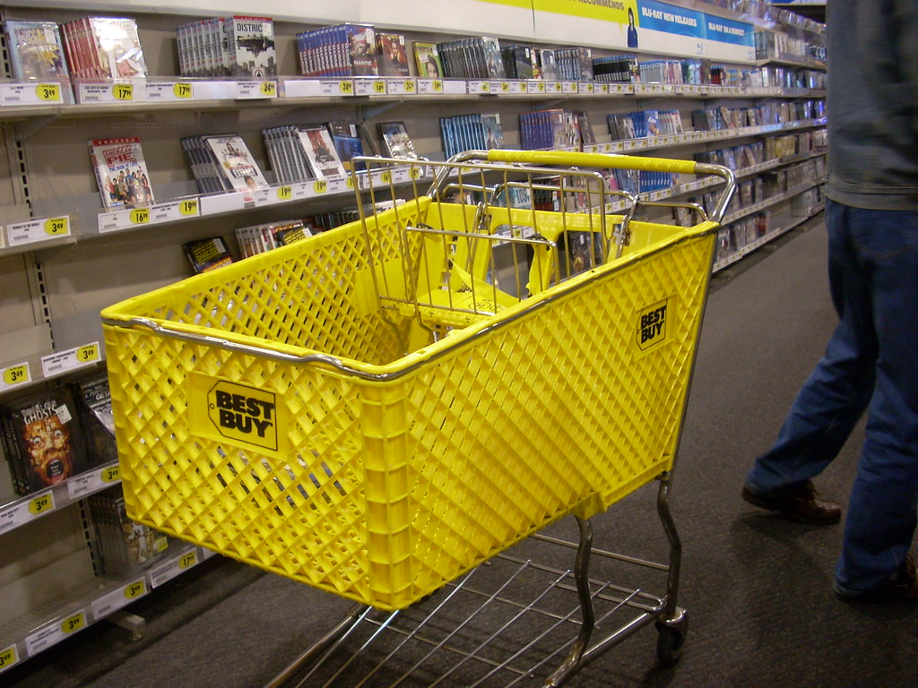
Coding Example
The Knapsack Problem
num_items = 4
value[] = [5, 4, 3, 2]
weights[] = [4, 3, 2, 1]
cart_limit = 6

Slide 6
Coding Example
The Knapsack Problem
Break it into sub-problems.
hint: A given item, can either be in the cart or not.
https://repl.it/@dsyang/DynamicProgramming
Notes:
Solutions: https://repl.it/@dsyang/DynamicProgrammingAns

Slide 7
Work-Time
Homework 6 has lots of DP problems
pdf on iLearn:
https://www.hackerrank.com/contests/cst370-s19-hw6/challenges
I suggest looking at leap frog or stairs first.
finished with everything? https://open.kattis.com/problems/longincsubseq
Notes:
Solutions: https://repl.it/@dsyang/DynamicProgrammingAns

